Slide 1
Traffic Light Challenge
Two examples …
... and a bunch of other things.

Slide 2
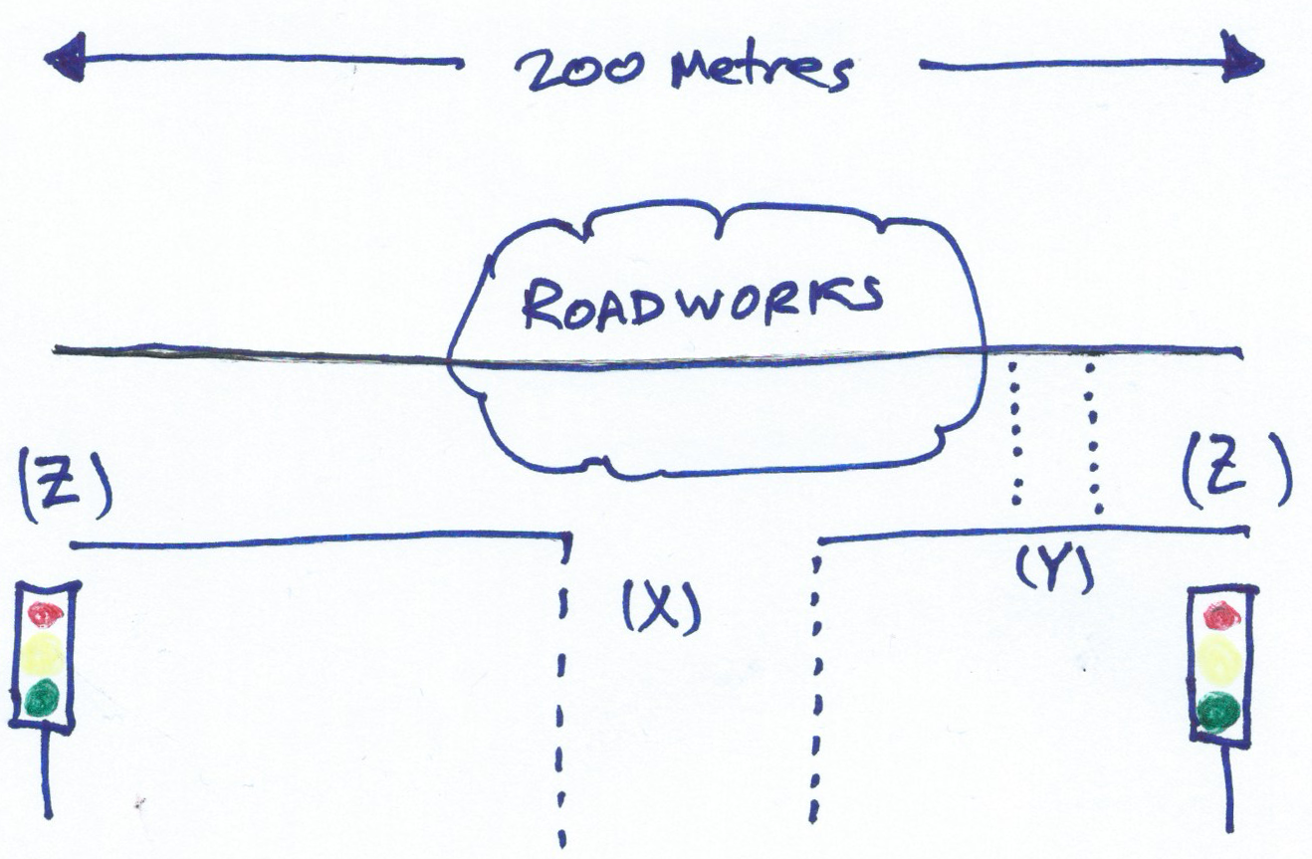
Remember:
Your challenge is…
To design and implement a Racket / Arduino traffic light system
Demonstratewhat you know about Racked, arduino, design, states, etc.

Slide 3
Some starting points: ASIP
Controlling Arduino
Remember the Arduino workshop?
AsipMain.rkt
#lang racket
(require "AsipMain.rkt”)
(define setup (lambda ()
(open-asip)
(set-pin-mode 13 OUTPUT_MODE)
))
(define mainLoop (lambda()
(digital-write 13 HIGH)
(sleep 1)
(digital-write 13 LOW)
(sleep 1)
(mainLoop)
))

Slide 4
Lights Version 1
Simple repeating light sequence:
Red
Red + Orange
Green
Orange
How can we represent this sequence in Racket?
(define lightSeq
(list
(list 1 0 0 )
(list 1 1 0)
(list 0 0 1)
(list 0 1 0)
))

Slide 5
Cycle through states
Current state:
(first lightSeq)
State change:
Remove first
Add to end of list!
(define lightCycle (lambda (seq)
(cond [(not (empty? seq))
(setLights lights (first seq))
(sleep 1)
(lightCycle
(append (rest seq)
(list (first seq))
)
)]
) ) )

Slide 6
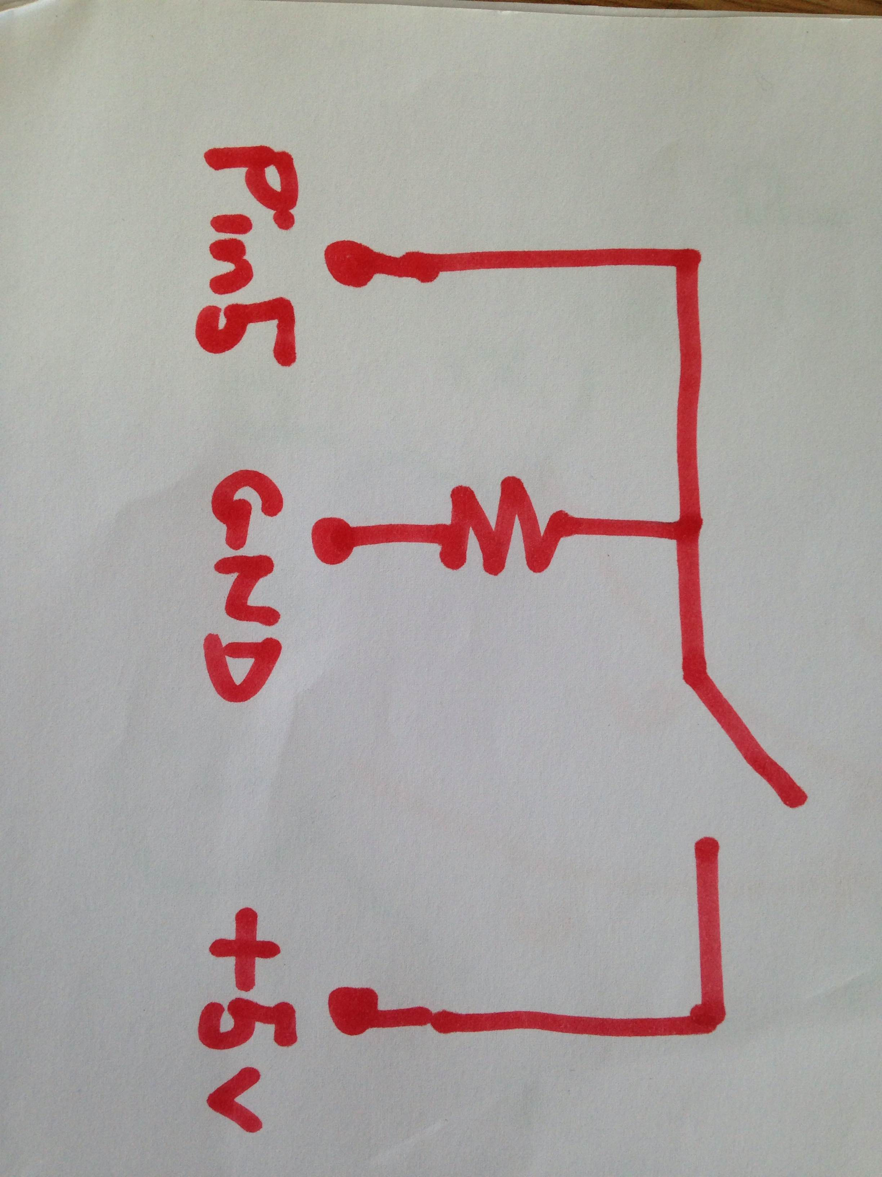
Version 2: making it reactive
How can we make the lights respond to user input?
Add a button
Button presses trigger state transitions
(require
"AsipButtons.rkt")
(on-button-pressed 5
(lambda ()
(printf “Press”)))

Slide 7
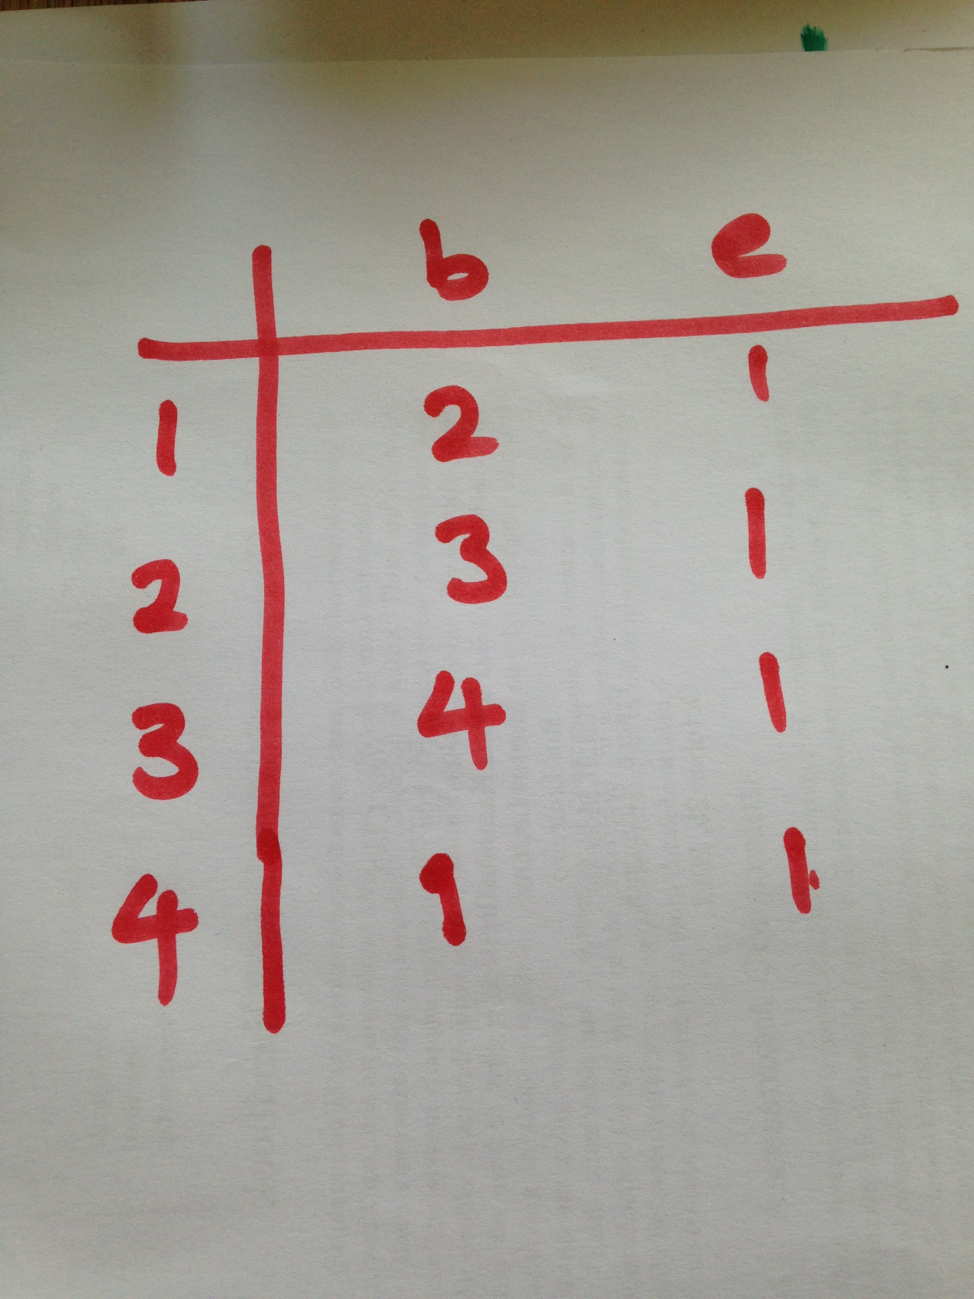
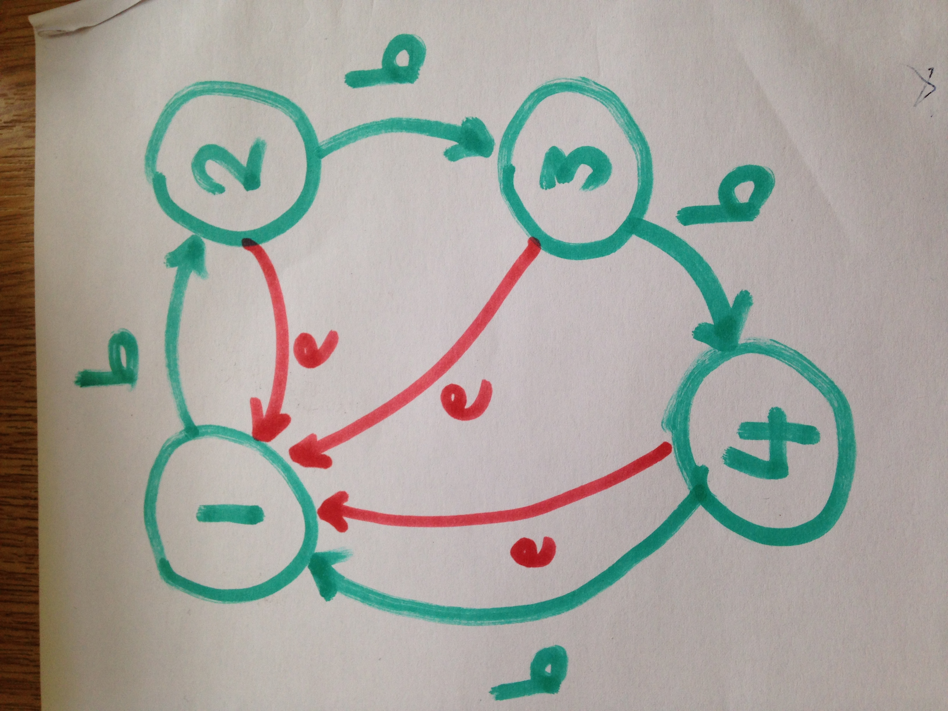
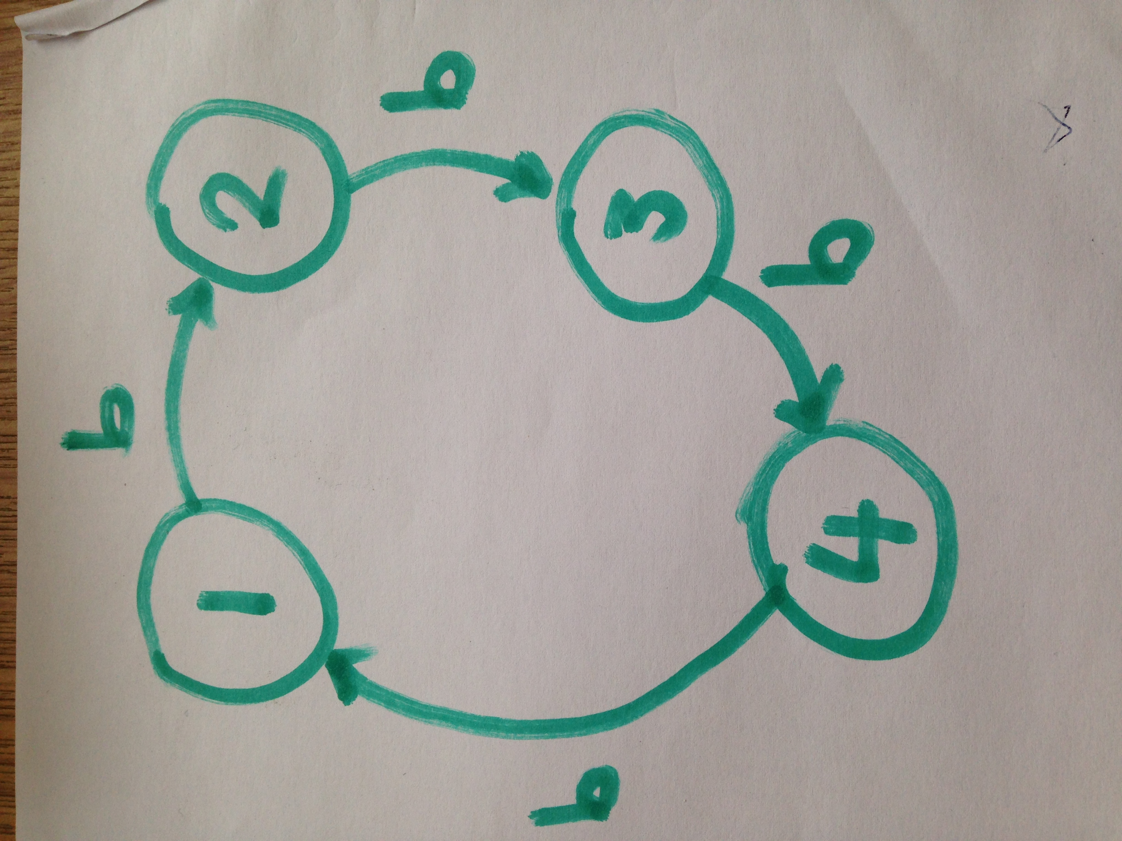
FSMs in Racket
Remember tabular representation of FSM:

Slide 8
Representation in Racket
Use the “hash” structure
Implementation of ‘tables’ or ‘mappings’
(define stateTable
(hash
1 (hash "b" 2 "e" 1 )
2 (hash "b" 3 "e" 1 )
3 (hash "b" 4 "e" 1 )
4 (hash "b" 1 "e" 1 )
) )

Slide 9
Manipulating state
Record the state
Figure out next
Update current
Set lights
(define currentState 1)
(getNextState state event)
(gotoNextState event)
(outputCurrentState)

Slide 10
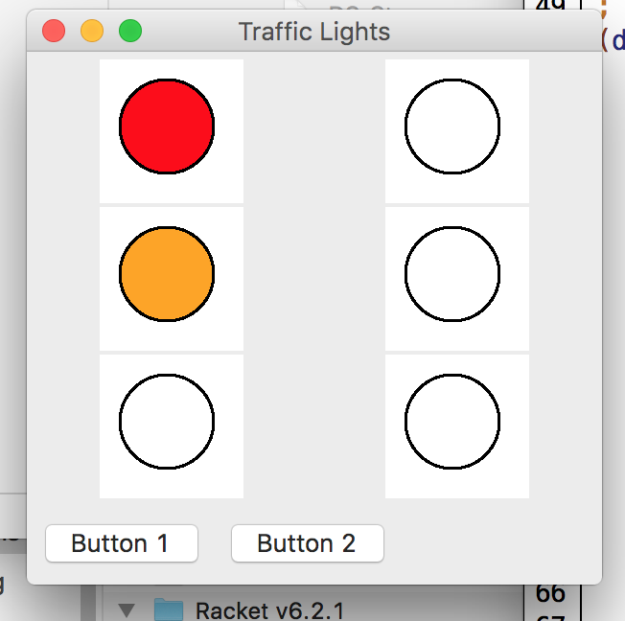
Finally…
Sometimes useful to test without an Arduino
GUI simulation
LEDs connected to pins 7, 8, 9, 11, 12, 13.
Buttons connencted to pins 5 & 6
Same functions as AsipMain
(require
"AsipSimulated.rkt“)

Slide 11
Summary
Examples:
SimpleSingleTraffic.rkt & DoubleTraffic.rkt
Files:
AsipMain.rkt & AsipUtilities.rkt
AsipButtons.rkt
AsipSimulated.rkt & AsipButtonsSimulated.rkt

